Slide 1
Satcom Chipset Evaluation
Confidential
2025.09.11
Incubating Center

Slide 2
Test Setup & Test Result
Chipset Evaluation Board
Test Evaluation Board Trace Loss
VNA (Vector Network Analyzer) Setup
SG-PM (Signal Generator-Power Meter) Setup
VNA-NF (Signal Analyzer-Noise Figure) Setup
Test Result Summary

Slide 3
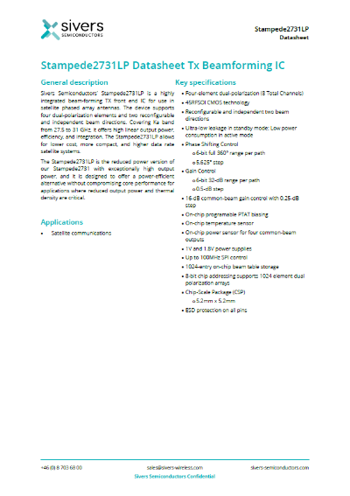


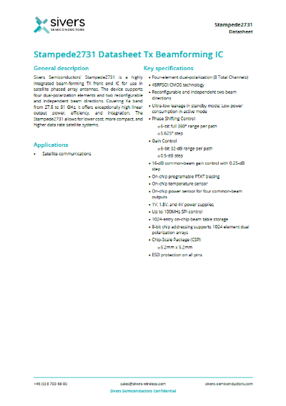
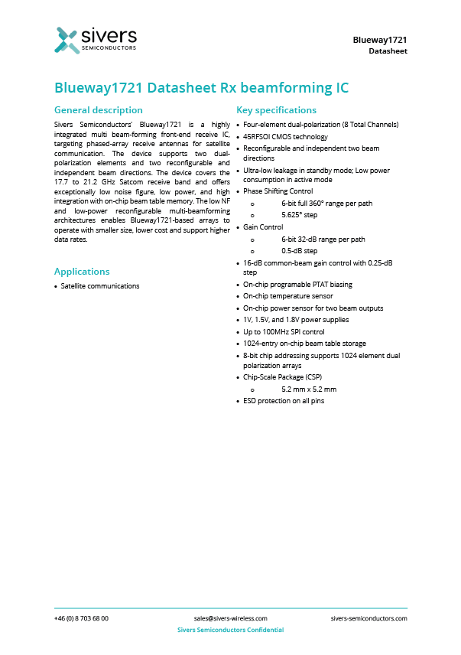
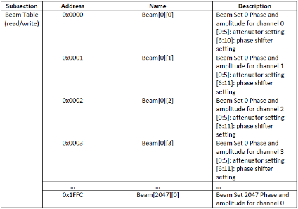
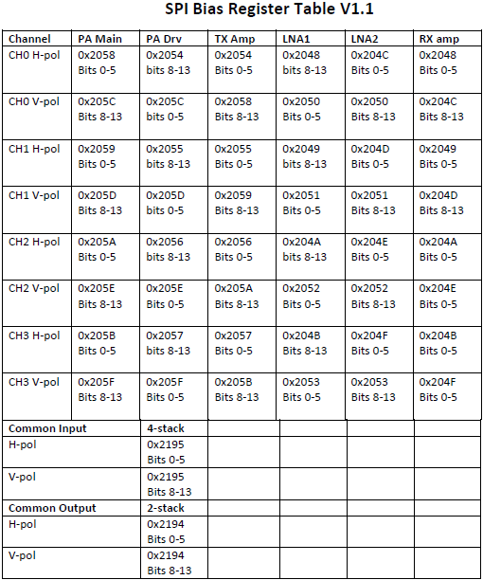
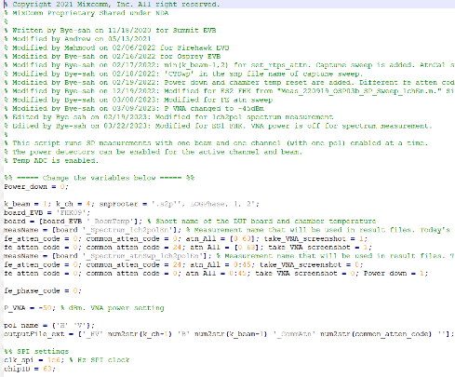
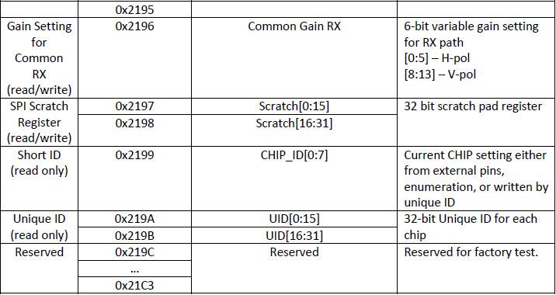
Documents for Test Procedure
Basic materials for chipset review
Stampede 2731 TX
Blueway 1721 RX
Stampede 2731LP TX
[ IC Datasheet ]
[ SPI Interface User Guide ]
[ CLI User's Guide ]
[ Register Map/Beam book Memory Map ]
[ PA / LNA Bias LUTs ]
[ Reference Source Code ]

Slide 4
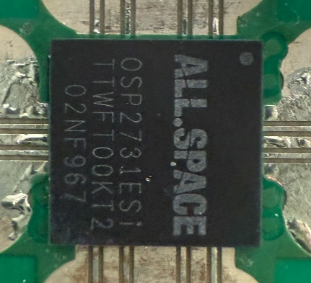
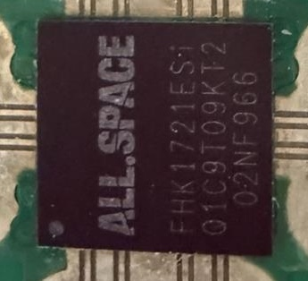
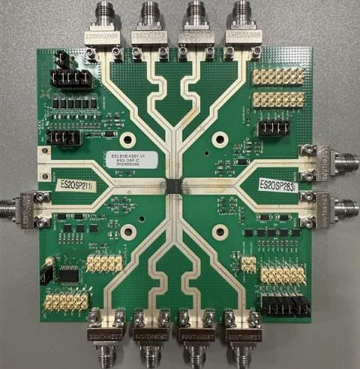
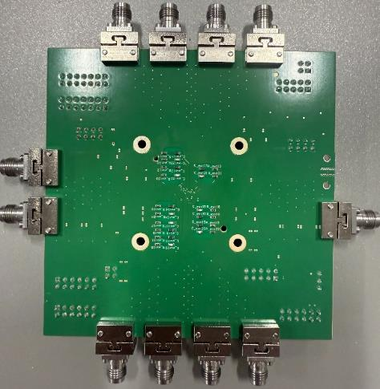
Satcom Chipset Evaluation Board
TX/RX IC evaluation board designed for UK customer, with specifications similar to Broad Market IC.
UK Company
UK Company
Evaluation Board
(TX 2731)
(RX 1721)
(Front)
(Back)

Slide 5
Test Evaluation Board Trace Loss
Check the RF cable and evaluation board trace loss in the frequency bands used for Ka-Band chipset verification.
Evaluation Board Trace Loss
ka-Band | Frequency (GHz) | RF Common |  | H Pol Channels |  |  |  | V Pol Channels
 |  | IO_H | IO_V | H0 | H1 | H2 | H3 | V0 | V1 | V2 | V3
Downlink band | 17.7 | 2.1 | 2.1 | 1.7 | 1.3 | 1.7 | 1.3 | 1.3 | 1.7 | 1.7 | 1.3
 | 18.5 | 2.2 | 2.2 | 1.8 | 1.4 | 1.8 | 1.4 | 1.4 | 1.8 | 1.8 | 1.4
 | 19.5 | 2.3 | 2.3 | 1.9 | 1.4 | 1.9 | 1.4 | 1.4 | 1.9 | 1.9 | 1.4
 | 20.0 | 2.4 | 2.4 | 1.9 | 1.5 | 1.9 | 1.5 | 1.5 | 1.9 | 1.9 | 1.5
 | 20.7 | 2.4 | 2.4 | 1.9 | 1.5 | 1.9 | 1.5 | 1.5 | 1.9 | 1.9 | 1.5
 | 21.2 | 2.5 | 2.5 | 2.0 | 1.5 | 2.0 | 1.5 | 1.5 | 2.0 | 2.0 | 1.5
Uplink band | 27.5 | 3.0 | 3.0 | 2.4 | 1.9 | 2.4 | 1.9 | 1.9 | 2.4 | 2.4 | 1.9
 | 28.7 | 3.1 | 3.1 | 2.5 | 1.9 | 2.5 | 1.9 | 1.9 | 2.5 | 2.5 | 1.9
 | 29.5 | 3.2 | 3.2 | 2.5 | 2.0 | 2.5 | 2.0 | 2.0 | 2.5 | 2.5 | 2.0
 | 30.0 | 3.3 | 3.3 | 2.7 | 2.0 | 2.7 | 2.0 | 2.0 | 2.7 | 2.7 | 2.0
 | 31.0 | 3.3 | 3.3 | 2.6 | 2.1 | 2.6 | 2.1 | 2.1 | 2.6 | 2.6 | 2.1
Ka-Downlink Band
Ka-Uplink Band

Slide 6

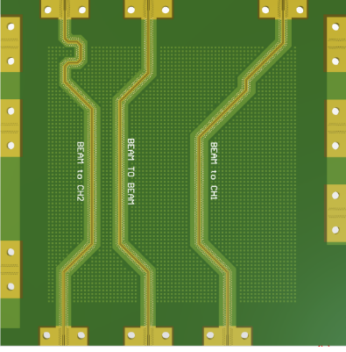
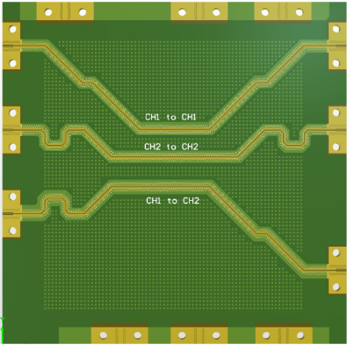
How to measure the trace loss
Common Path
Channel Path
➊
❷
➌
➌
➊
❷
(Common Trace dummy)
(CH Trace dummy)

Slide 7
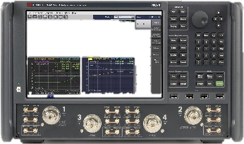
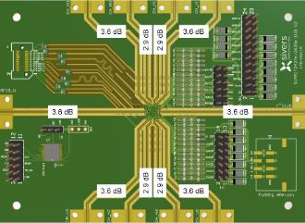
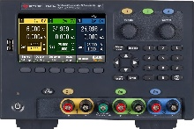
VNA Setup
Measurement of S-Parameters to evaluate Return Loss and Gain across the entire frequency band.
(3) Power Supply
(5-Ch)
(1) Vector Network Analyzer
PA 4.0 V
I/O 1.8 V
ANA 1.8 V
DRV 1.8 V
DIG 1.0 V
In/Out
CH_V3
CH_H3
CH_H2
CH_V2
(1) Keysight N5224B
Evaluation
Common Loss
RF_IO_V
RF_IO_H
Channel Loss
RF Cable
(2) Keysight E36312A
CH_V1
CH_H1
CH_H0
CH_V0
RF Cable
(S-Parameter Test Block Diagram)
Termination
Offset Calculation
SG (Signal Generator) : Cable Loss (w/Zero Cal.) + Channel Trace Loss
Signal Analyzer : Cable Loss (w/Zero Cal.) + Common Trace Loss
1) VNA (Vector Network Analyzer)

Slide 8
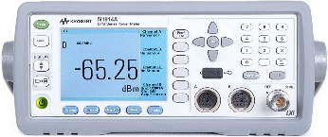
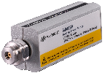

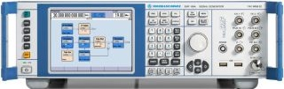
SG-Power Meter Setup
Measurement of CW and Modulation to evaluate Power, Gain and Pdc across the entire frequency band.
(1)
Power Meter
(3) Power Supply
(5-Ch)
Signal Generator
In
Out
PA 4.0 V
I/O 1.8 V
ANA 1.8 V
DRV 1.8 V
DIG 1.0 V
*w/ 10 dB Attn
Sensor
CH_V3
CH_H3
CH_H2
CH_V2
RF Cable
Evaluation
Keysight N1914A
(w/ N8488 Power Sensor)
Direct
Connect
Common Loss
RF_IO_V
RF_IO_H
Receiver Path
Channel Loss
Transmit Path
(2) Rohde SMF100A
(2) Signal Generator
CH_V1
CH_H1
CH_H0
CH_V0
Power Meter
Out
In
Direct
Connect
Sensor
RF Cable
*w/ 10 dB Attn
(3) Keysight E36312A
(Tx and Rx Test Block Diagram)
Termination
Signal Generator
RF Cable
Power Meter
Offset Calculation
SG (Signal Generator) : Cable Loss (w/Zero Cal.) + Channel Trace Loss
Signal Analyzer : Cable Loss (w/Zero Cal.) + Common Trace Loss
Sensor
Zero-Calibration
1) SG-SA (Signal Generator – Analyzer)

Slide 9
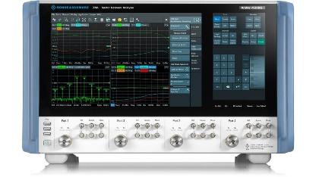
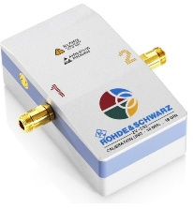
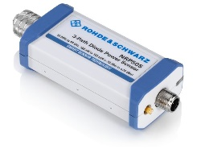
VNA-NF Setup
Measurement of NF to evaluate noise figure across the entire frequency band.
(3) Power Supply
(5-Ch)
(1) Vector Network Analyzer
PA 4.0 V
I/O 1.8 V
ANA 1.8 V
DRV 1.8 V
DIG 1.0 V
In/Out
CH_V3
CH_H3
CH_H2
CH_V2
(1) Rodhe ZNA
Evaluation
Common Loss
RF_IO_V
RF_IO_H
Channel Loss
RF Cable
(2) Rodhe ZV-Z55
CH_V1
CH_H1
CH_H0
CH_V0
RF Cable
(3) Rodhe NRP50S
(NF Test Block Diagram)
Termination
Measurement procedure
S-Parameter Calibration(ZV-Z55), Power Calibration(NRP50S), Receiver Noise Calibration(50Ω termination)
Hook up DUT (P1→in, out→P2), Read NF and Gain; NF21, b2/a1, NF2R, ND2 …
1) VNA-NF (Signal Analyzer – Noise Figure)

Slide 10
Test Result Summary(Datasheet, @21 dBm)
Category |  | Test Items | Results | Datasheet (Spec) | Comments (with Action Plan)
DC/ RF | Common | - Attenuation Accuracy (Common-Channel Range/Step) | Meet | Common : 16 dB / 0.50 dB Channel : 32 dB / 0.50 dB | Gain Range - Tx : 16.26 / 8.23, Rx : 16.86/ 8.01 dB (0.25 dB Attn less accurate, 0.25 not supported on Stampede and Blueway, Channel Attn measures up to 8 dB)
 |  | - Frequency vs Gain - Channel Gain Alignment | Meet | - | 8 channels /1 beam : 3.6 ~ 5 dB (Min ~ Max) (Spot calibration, etc., is required to minimize gain alignment)
 | TX | - Pin Sweep vs Pout Linearity (at OP1dB per channel) | Meet | 21 dBm | 20.14 dBm
 |  | - Pdc (Single, 8 Channels / 2 Beam) | Meet | 625 mW / 5 W | 660 mW / 4.7 W (with leakage : 19.3 mW)
 |  | Isolation | Meet | > 25 dB | 25.12 / 31.57 / 37.40 dB (Min-Typ-Max with All Band)
 |  | - EVM Bathtub Curve | (TBD) | (TBD) | *Future measurement
 | RX | - Pin Sweep vs Pout Linearity (iP1dB per channel) | Meet | -33 dBm | -38.02 dBm (Firehawk is more than the gain of Blueway. That is why iP1dB is ~ 4 dB lower)
 |  | - Pdc (Single, 8 Channels / 2 Beam) | Meet | 59.38 mW / 475 mW | 90 mW / 584 mW (with Idle Pdc : 19.3 mW) (the Blueway IC has lower gain and Pdc than the Firehawk IC reason why is one amplification stage less)
 |  | - RX Sensitivity (Pin sweep vs SNR) | (TBD) | - | *Future measurement
 |  | - Frequency vs Noise Figure (RX NF Max at Single-Channel) | Meet | 2 dB | 1.84 ~ 2.54 dB (17.7~21.2 GHz) (Need to optimized to satisfied within spec)

Slide 11
Common Performance Evaluation
Attenuation Accuracy
Frequency vs Gain
Channel Gain Alignment
Gain vs PA / LNA Bias over temperature
Temperature Sensor Accuracy

Slide 12
Attenuation Control
Designed to control gain of Common and Channel Paths by Stage-Attenuation
Common (16 dB with 0.25 dB Step)
Channel (32 dB with 0.25 dB Step)
Bits
(6-Bit)
0
1
2
3
4
5
(7-Bit)
0
1
2
3
4
5
6
Stage Atten.(dB)
(15.75)
0.25
0.5
1
2
4
8
(31.75)
0.25
0.5
1
2
4
8
16
Control Bits
dB / Bits | 0 | 1 | 2 | 3 | 4 | 5
0 dB | 1 | 1 | 1 | 1 | 1 | 1
0.25 dB | 0 | 1 | 1 | 1 | 1 | 1
0.50 dB | 1 | 0 | 1 | 1 | 1 | 1
0.75 dB | 0 | 0 | 1 | 1 | 1 | 1
1.00 dB | 1 | 1 | 0 | 1 | 1 | 1
2.00 dB | 1 | 1 | 1 | 0 | 1 | 1
4.00 dB | 1 | 1 | 1 | 1 | 0 | 1
8.00 dB | 1 | 1 | 1 | 1 | 1 | 0
- | - | - | - | - | - | -
15.50 dB | 1 | 0 | 0 | 0 | 0 | 0
15.75 dB | 0 | 0 | 0 | 0 | 0 | 0
dB / Bits | 0 | 1 | 2 | 3 | 4 | 5 | 6
0 dB | 1 | 1 | 1 | 1 | 1 | 1 | 1
0.25 dB | 0 | 1 | 1 | 1 | 1 | 1 | 1
0.50 dB | 1 | 0 | 1 | 1 | 1 | 1 | 1
0.75 dB | 0 | 0 | 1 | 1 | 1 | 1 | 1
1.00 dB | 1 | 1 | 0 | 1 | 1 | 1 | 1
2.00 dB | 1 | 1 | 1 | 0 | 1 | 1 | 1
4.00 dB | 1 | 1 | 1 | 1 | 0 | 1 | 1
8.00 dB | 1 | 1 | 1 | 1 | 1 | 0 | 1
16.00 dB | 1 | 1 | 1 | 1 | 1 | 1 | 0
- | - | - | - | - | - | - | -
31.75 dB | 0 | 0 | 0 | 0 | 0 | 0 | 0
(0 is enable)
Note
Currently, the use of a 0.25 dB attenuation is not recommended from Sivers (i.e., the 0.25 dB Step is limited)

Slide 13
TX Attenuation Accuracy
Check the Range and Step of Gain attenuation with the given Index control of Common and Channel as SG-PM test environment.
Max - Min
(16.26 dB)
28.04 dB
(Idx. 0)
Max - Min
(8.43 dB)
18.22 dB
(Idx. 63)
**Not Uniform Gain Reduction
(Reduced like stair shape)
19.61 dB
(Idx. 32)
Note
TX-29 GHz-B0-H0 / Channel Gain is tested up to ~127 Index, but up to ~33 Index

Slide 14
TX Attenuation Accuracy (1 dB Step)
Check the Range and Step of Gain attenuation with the given Index control of Common and Channel as SG-PM test environment.
34.48 dB
(Idx. 0)
Max - Min
(16.26 dB)
28.04 dB
(Idx. 0)
Max - Min
(8.43 dB)
18.22 dB
(Idx. 63)
19.61 dB
(Idx. 32)
Note
TX-29 GHz-B0-H0 / Channel Gain is tested up to ~127 Index, but up to ~33 Index / Except 0.25, 0.5 dB Attn. bit

Slide 15
RX Attenuation Accuracy
Check the Range and Step of Gain attenuation with the given Index control of Common and Channel as SG-PM test environment.
41.48 dB
(Idx. 0)
Max - Min
(16.86 dB)
35.06 dB
(Idx. 0)
Max - Min
(8.01 dB)
24.62 dB
(Idx. 63)
27.05 dB
(Idx. 32)
**Not Uniform Gain Reduction
(Reduced like stair shape)
Note
RX-29 GHz-B0-H0 / Channel Gain is tested up to ~127 Index, but up to ~33 Index

Slide 16
RX Attenuation Accuracy (1 dB Step)
Check the Range and Step of Gain attenuation with the given Index control of Common and Channel as SG-PM test environment.
41.48 dB
(Idx. 0)
Max - Min
(16.86 dB)
35.06 dB
(Idx. 0)
Max - Min
(8.01 dB)
24.62 dB
(Idx. 63)
27.05 dB
(Idx. 32)
Note
RX-29 GHz-B0-H0 / Channel Gain is tested up to ~127 Index, but up to ~33 Index / Except 0.25, 0.5 dB Attn. bit

Slide 17
Channel Gain Alignment (TX)
Using a VNA, verify the gain alignment accuracy for each channel of 8 channels/1 beam
Need to calibration for each channel
≑ 5 dB
Note
Fc: 28 GHz, Typical Gain (Common atten index : 28, Channel atten index : 0), All channel enable (H0:3, V0:3),

Slide 18
TX Performance Evaluation
Pin Sweep vs Pout Linearity (OP1dB)
Single channel
8 Channels / 2 Beam
Isolation (> 25 dB)
EVM Bathtub Curve (Pin Sweep vs EVM)

Slide 19
TX Pin Sweep vs Pout Linearity (Single Channel)
Using a SG-SA, verify the power saturation, OP1dB, Pdc.
OP1dB
Note
TX-29 GHz-B0-H0

Slide 20
TX Pin Sweep vs Pout Linearity (8 Channels / 2 Beam)
Using a SG-SA, verify the power saturation, OP1dB, Pdc.
OP1dB
Note
TX-29 GHz-B0-H0

Slide 21
Isolation (> 25 dB)
Using a VNA, verify the isolation of channel between H and V, as well as the dual stream between channels
Isolation Requirement | Spec | B0-H0 to B0-V0 (Min) | B0-H0 to B0-V0 (Avg) | B0-H0 to B0-V0 (Max)
Osprey 2731 | > 25 dB | -25.12 dB | -31.57 | -37.40
Note
Typical Gain (Common atten index : 28, Channel atten index : 0)

Slide 22
RX Performance Evaluation
Pin Sweep vs Pout Linearity (iP1dB)
Single channel
8 Channels / 2 Beam
RX Sensitivity (Pin sweep vs SNR)
Frequency vs Noise Figure

Slide 23
RX Pin Sweep vs Pout Linearity (Single Channel)
Using a SG-SA, verify the iP1dB, and Pdc
iP1dB
Note
RX-29 GHz-B0-H0

Slide 24
RX Pin Sweep vs Pout Linearity (8 Channels/2 Beam)
Using a SG-SA, verify the iP1dB, and Pdc
iP1dB
Note
RX-29 GHz-B0-H0

Slide 25
RX Frequency vs Noise Figure
Using a VNA-NF, Noise Figure Measurement in 17.7 to 21.2 GHz Band Range
Note
RX-B0-H0, RX-B1-V0

